Slide 1
A Brisk Stroll through AzureML Studio
Understanding what is available and how to use it

Slide 2
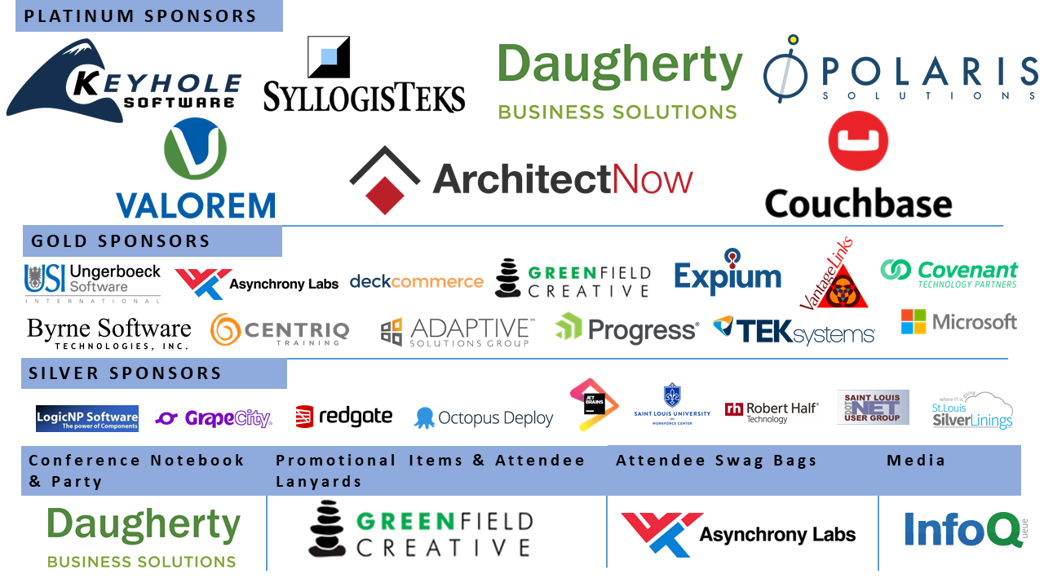

Slide 3
Consultant for over 20 years with experience in:
BI & Data Analytics
Application development
SCRUM Master
Project Management
Business Analysis & Quality Assurance
Team Development
Kevin Queen
Director at Oakwood Systems Group Inc.
Microsoft Professional Program in Data Science
Dataspelunk.com @KevQueen
kevindqueen@outlook.com

Slide 4
Agenda
Bring the code to the data
What is AzureML Studio
How to get data in
Setting up an experiment
Studio Interface
What is available
How to use the interface
Sharing Experiments
Publishing Web Services
Speed up cleansing and modeling
Turn data into actionable intelligence

Slide 5
Web browser interface
Azure hosted storage and execution
Web services for actionable results
Prebuilt parameterized models and methods
Azure ML Studio
But wait there’s more!
Pull in custom R and Python scripts

Slide 6
General Process Overview
Obtain data
Model, Train, Test and Evaluate
Define the problem and desired outcome
Data Munge
Data Wrangle
Present and Incorporate into Solutions
These are iterative processes. However your organization depicts this, the end goal is Actionable Intelligent Information.
Building results into solutions enhances the return on investment.
Notes:
10:35

Slide 7
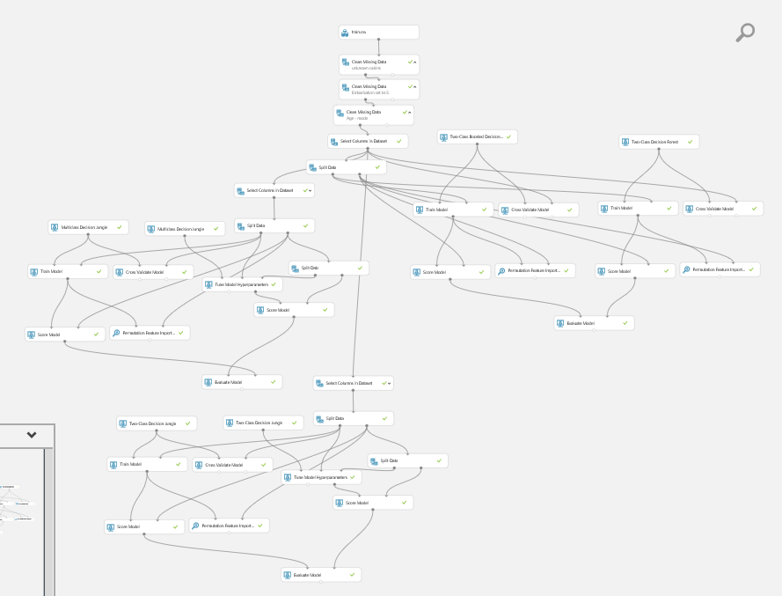
Data prep
AzureML Studio Experiment
Model 1
Model 2
Model 3
This experiment tunes and compares four models
Each rectangle is a module or step
Lines show the data flow
Model 4

Slide 8
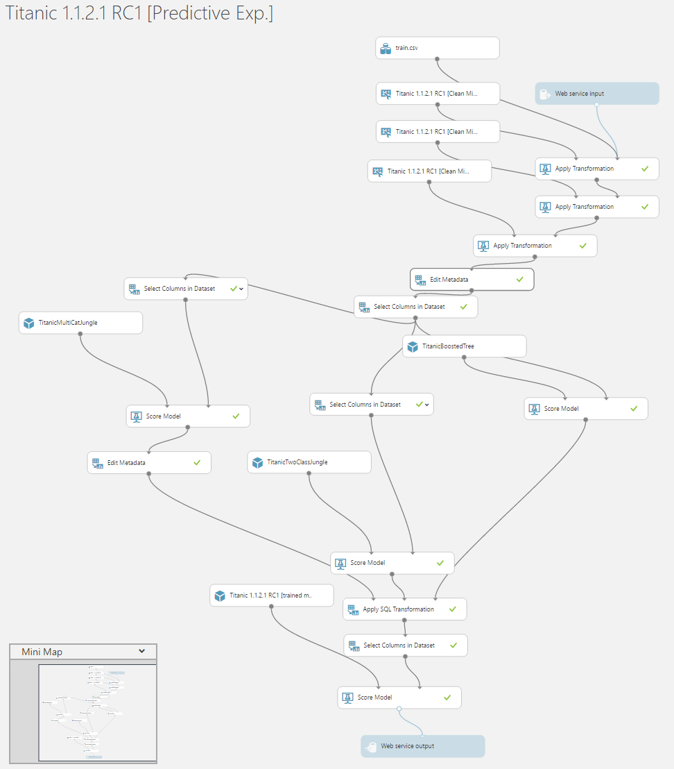
AzureML Studio Predictive Experiment
Transforms the training experiment into a predictor
Adds web service input and output
Uses trained models and data transformations from training experiment
Can then be tweaked and published

Slide 9
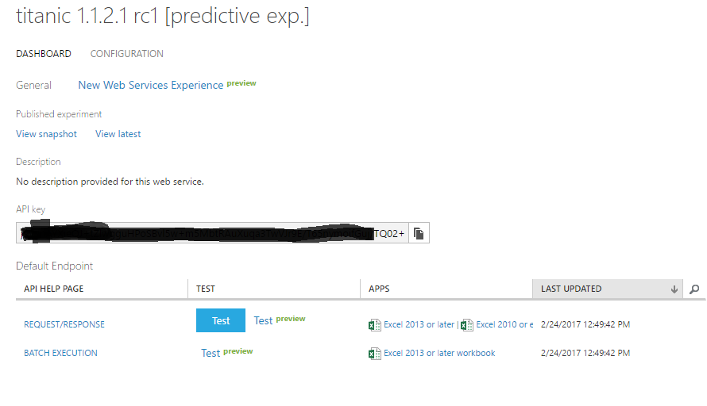
AzureML Studio Web Service
Web Service can be called using API key and URLs provided
Test button allows entering input data for on the spot testing
Test links provide html interface for manual usage / testing.
Excel client download to use web service

Slide 10
Demo Time
Walk through obtaining and wrangling data
Training a model and transforming it into a predictor
Publishing and using the web service
Notes:
10:45

Slide 11
Data Sources and Access
~40 Sample Datasets built in for experimentation
Pull, upload, save and combine data sources from:
CSV, TSV, TXT, SVMLight, ARFF, RData files
Web URL via HTTP
Hive Query
Data Feed
Azure DocumentDB
Azure Tables and Blob Storage
Azure or on premise SQL Database
Data Gateway access to on premise data
Data can be cached or refreshed after initial load into the experiment
Zip and Gzip supported for files

Slide 12
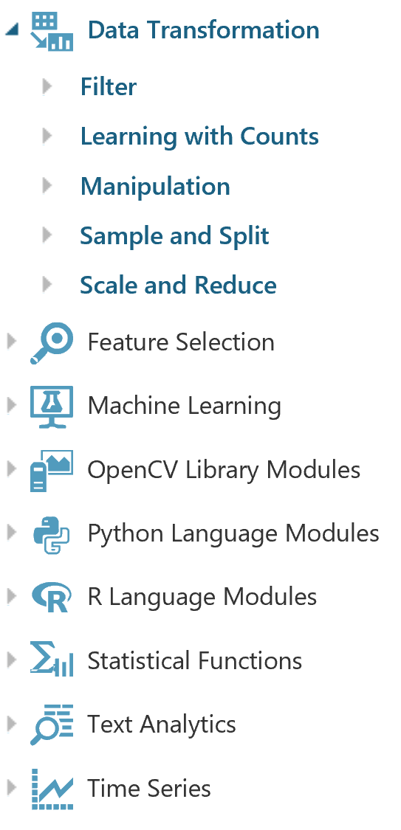
Azure ML provides a large selection of modules to facilitate data cleansing, normalization, and factor engineering.
Both R and Python scripts can also be leveraged to take advantage of existing work or popular packaged libraries
Specialized analytics models continue to be added
Notes:
visualize data set and walk thorough setting unknown for missing items

Slide 13
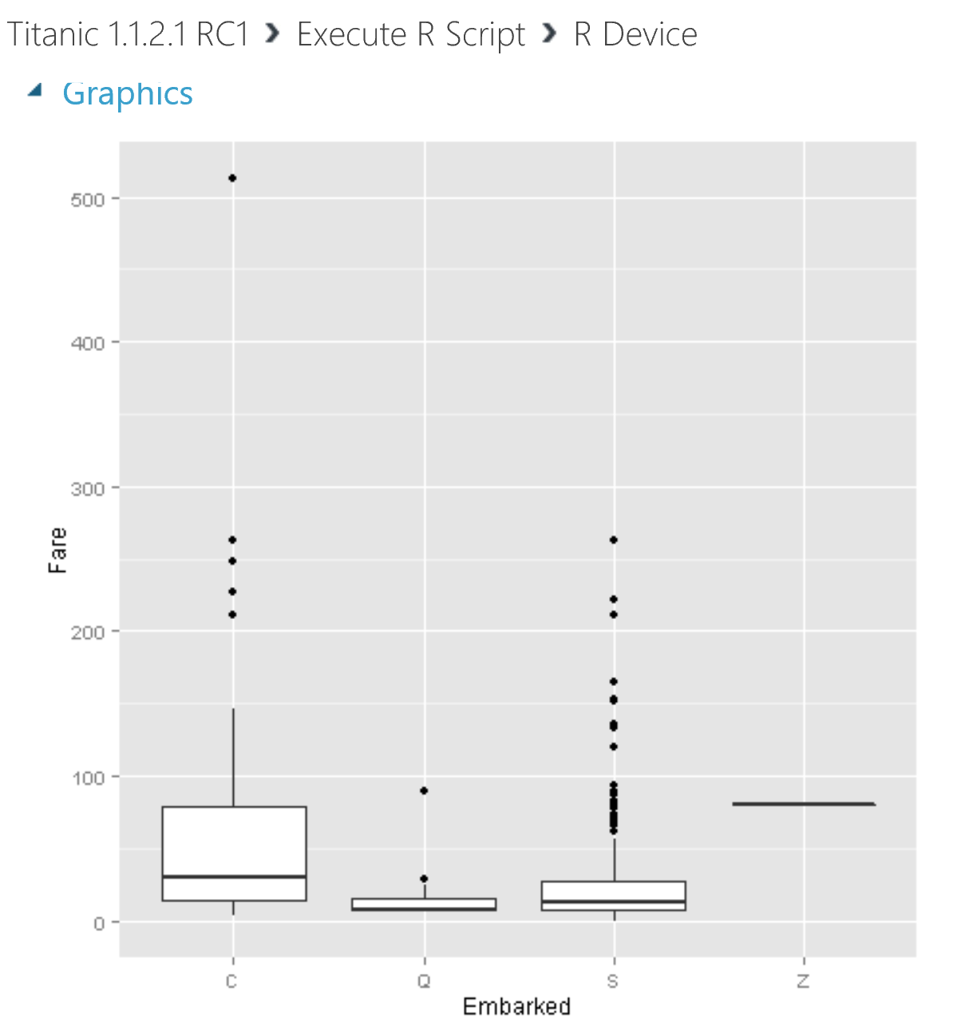
Visualize R and Python outputs without downloading all the data.
Here we used ggplot to compare unknown “Z” points with fares from known points. We see they would be outliers if assigned to Q or S, but fit well within what would be expected from C.

Slide 14
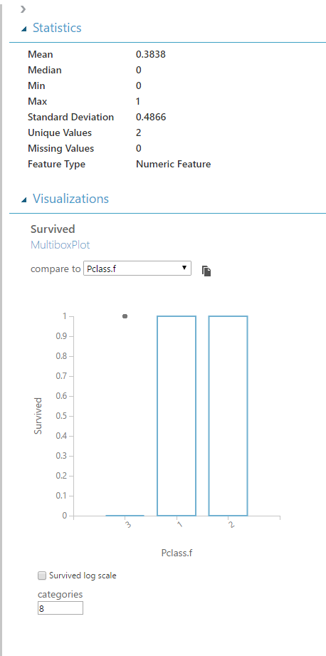
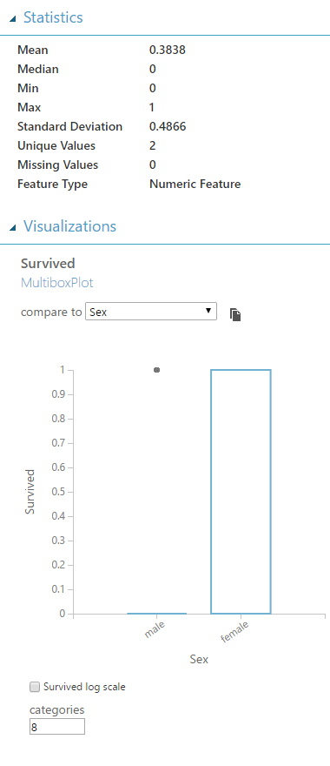
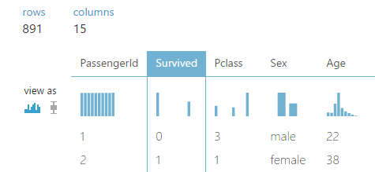
Data Visualizations
You can get an overview of the data and some of the relationships.
Below we see more perished than survived. Men outnumbered women ~ 2:1
Survival for men and 3rd class passengers was less likely than for women or 1st and 2nd class.

Slide 15
Finished data cleansing?
Time to create a model
Notes:
10:55

Slide 16
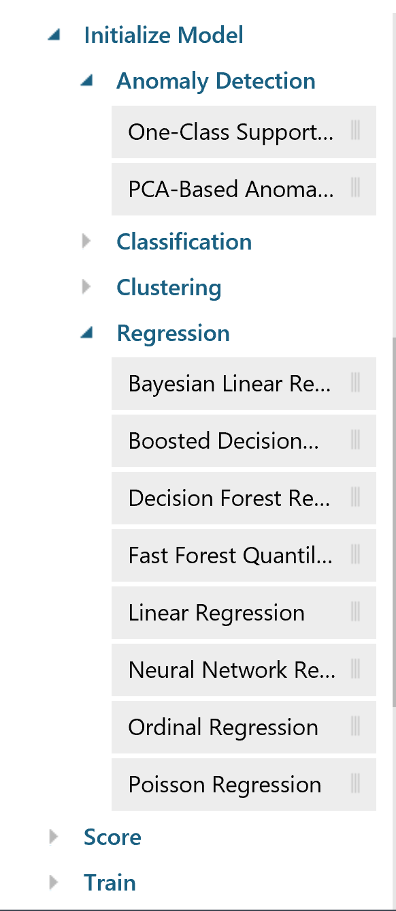
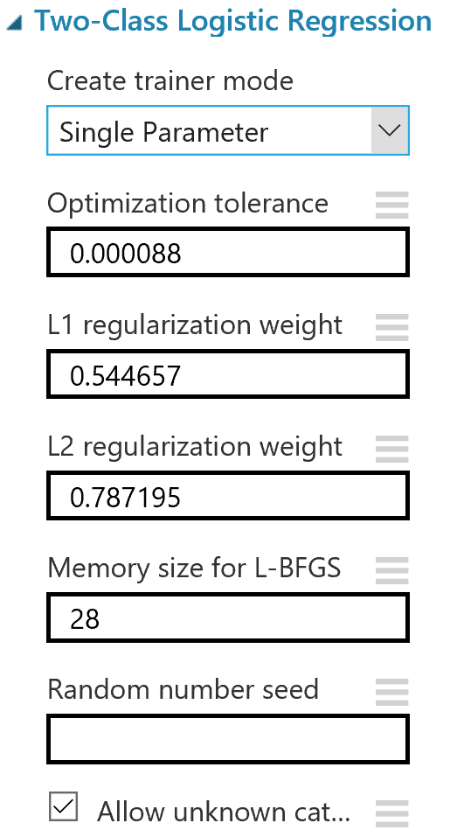
Multiple Machine Learning models come baked in, to include Anomaly Detection, Clustering and Regression. Fourteen different Classification models are ready out of the box. R and Python models can be added as well.
Models allow for easy parameter setting and random seeds can be set for repeatability

Slide 17
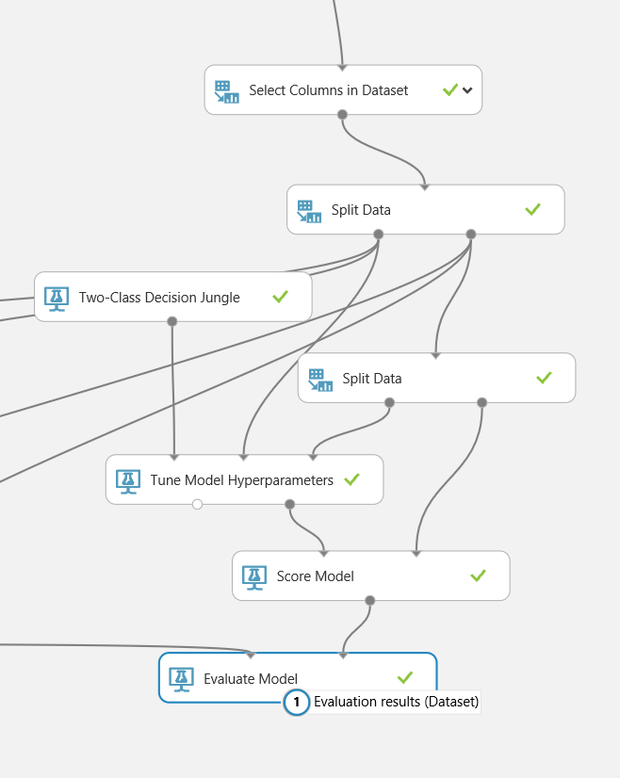
Automated Testing and Tuning
Tune Parameters using grids or random sweeps across designated parameter value ranges to quickly improve model performance

Slide 18
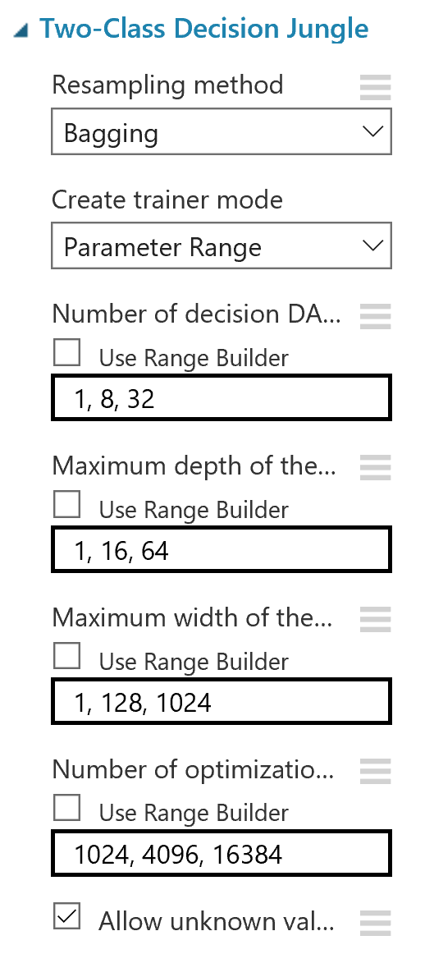
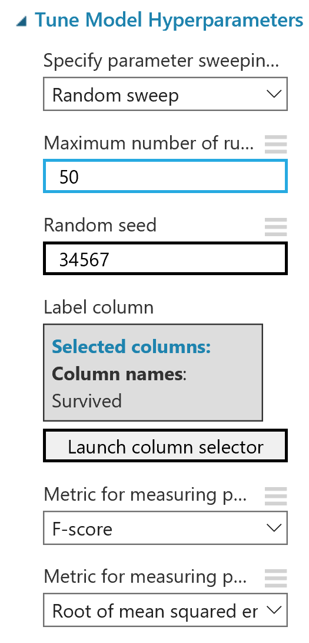
Tuning Parameters
Set the value ranges for your model parameters
Use Random sweeps, random grid, or test the entire grid of selected values to identify best performance for the selected metric and measure
Notes:
11:05

Slide 19
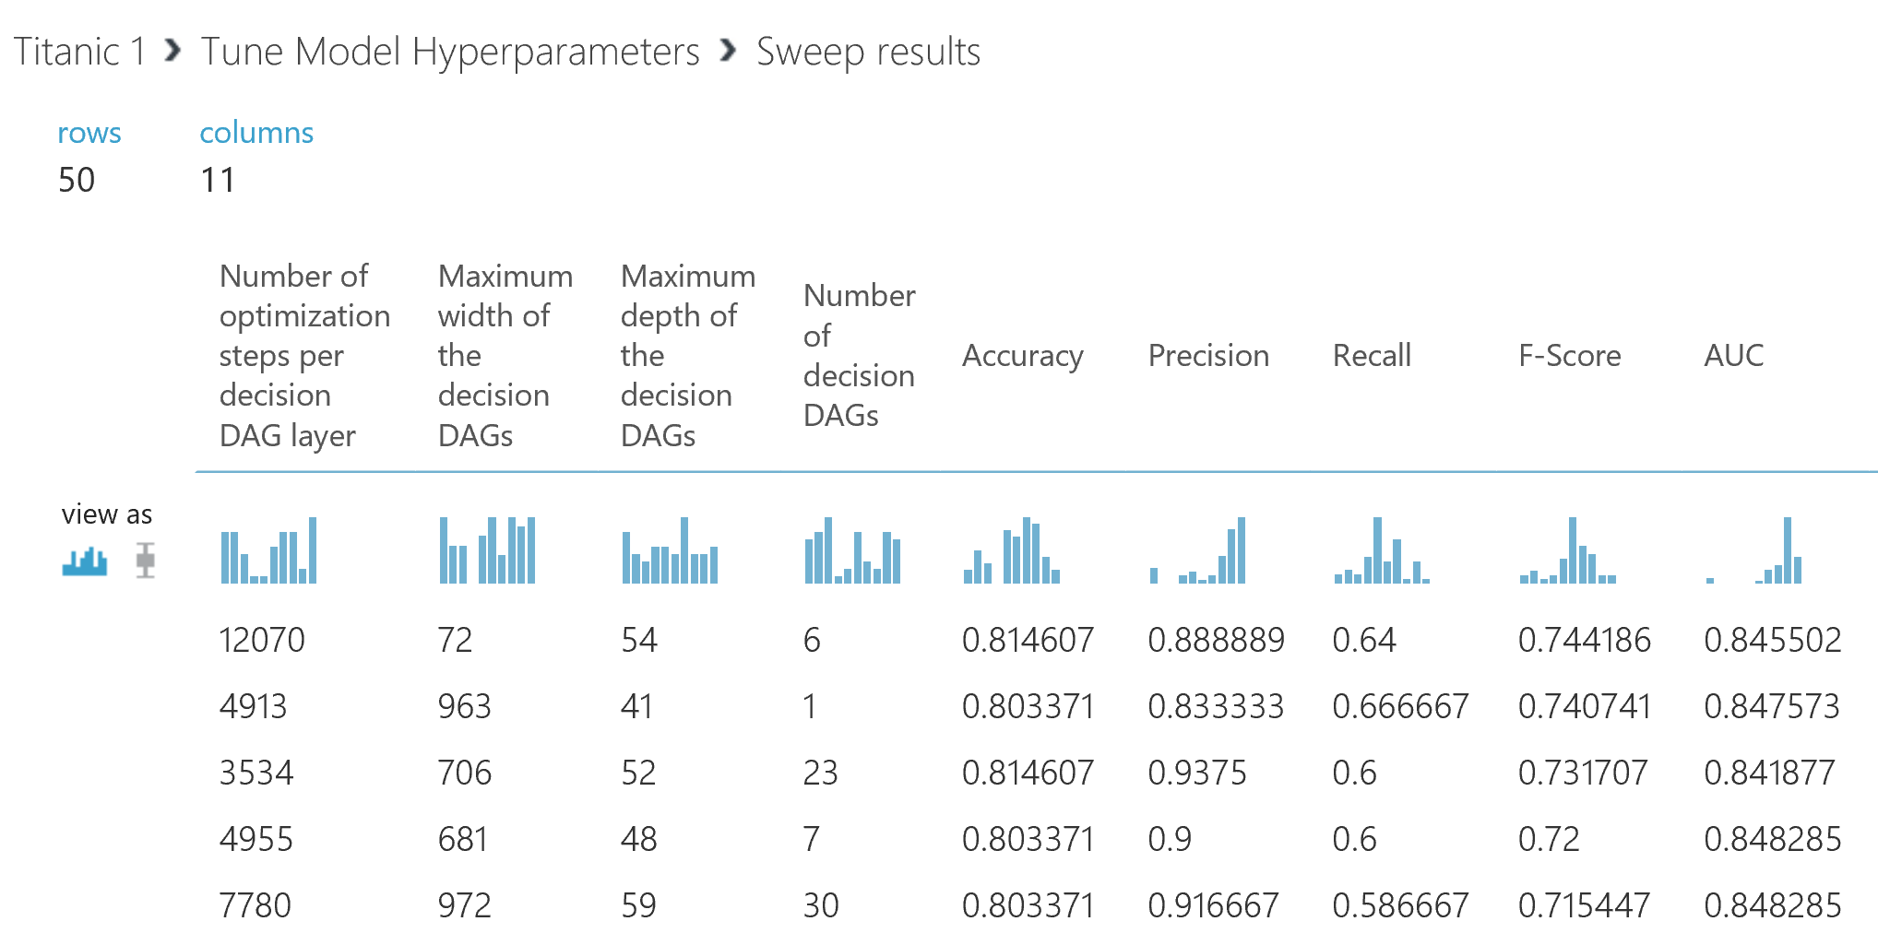
Results are ranked by the selected metric

Slide 20
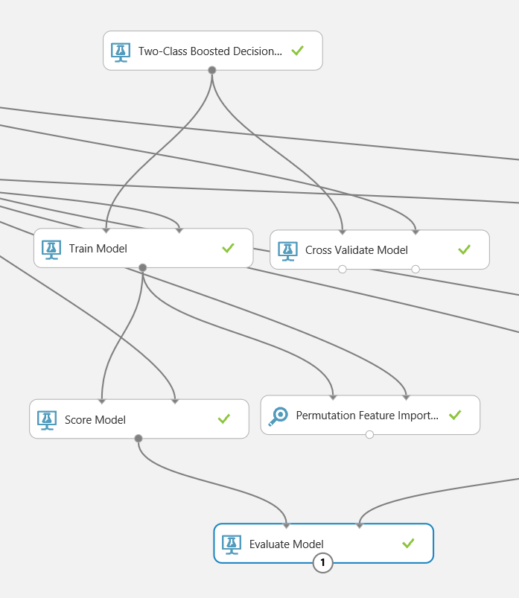
Automated Testing and Tuning
Cross Validate to guard against overfitting
Permutation Feature Importance to help intelligently simplify models while improving results

Slide 21
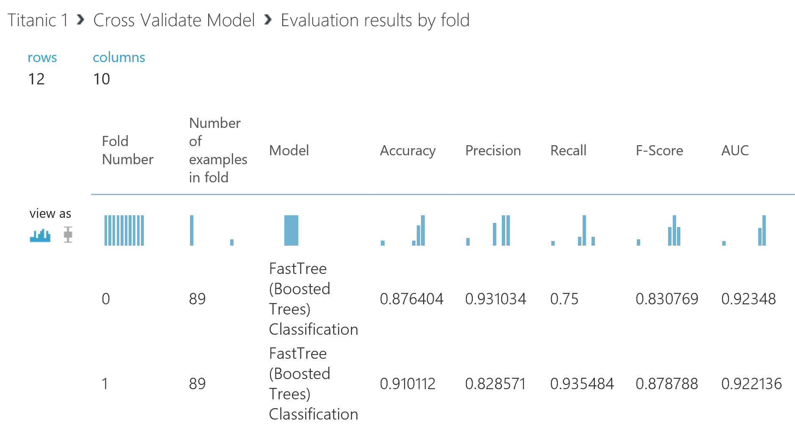
Compare mean and standard deviation of each metric across 10 folds to measure metric variance across data subsets
Gain confidence that the model is not overfitted to the training subset.
Notes:
Avg Log Loss – penalty for wrong results Training Log Loss – advantage over a random prediction

Slide 22
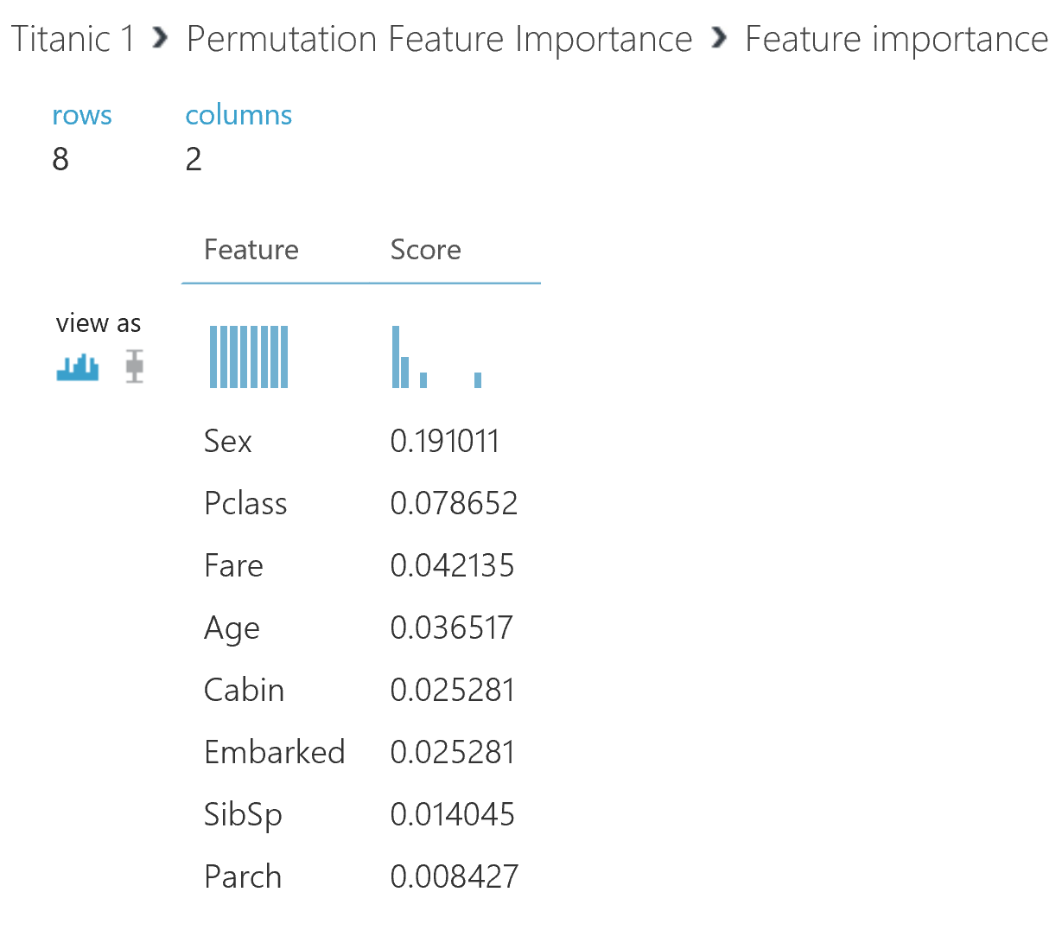
Visualizations make it easy to identify which features are candidates to be trimmed

Slide 23
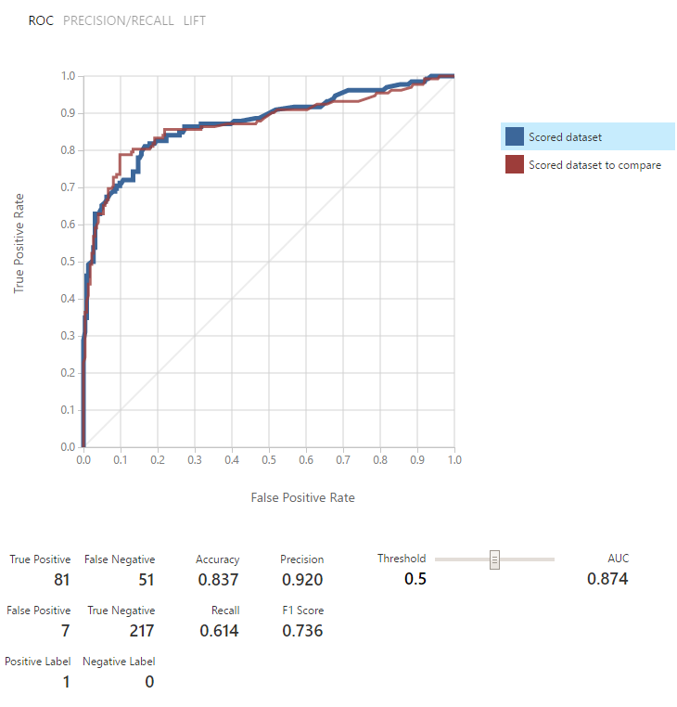
Compare Models
This is an example of a binary classification problem.
These two models are actually quite similar in performance. Clicking on the blue and red buttons changes which models stats appear – while both are graphed together.
Key metrics for the type of problem being assessed are displayed. In this case Accuracy, Precision, Recall, F1 Score and the Area Under the Curve.
Notes:
11:10

Slide 24
Training experiments build and tune the model
Conversion to a predictive experiment allows for data to be submitted with results returned
Integrate results into applications
Create a published web service that can be called externally

Slide 25
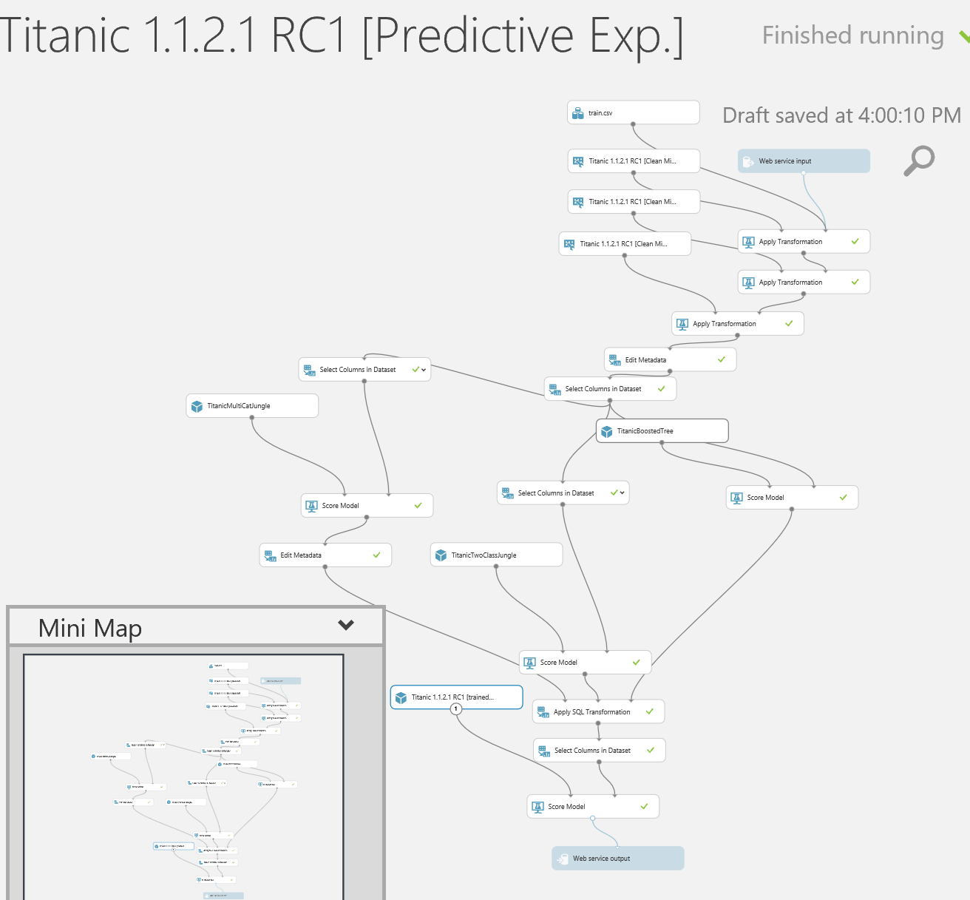
Azure ML Studio will auto convert your training experiment into a predictive experiment
Data import and export modules are added to capture the case data and resulting prediction
By default, web endpoints are provided but Azure SQL, blobs and tables can be used to store inputs and results as well

Slide 26
Turning the results into action
Published web services have an external URL and an API key to control access.
Apps, services, etc. can be written to leverage this to provide scenario data and receive back a prediction
Input data and results can exist in Azure storage or SQL
Can also use Excel AzureML Add In for a quick and easy way to submit data to and receive back predictions
Notes:
11:20

Slide 27
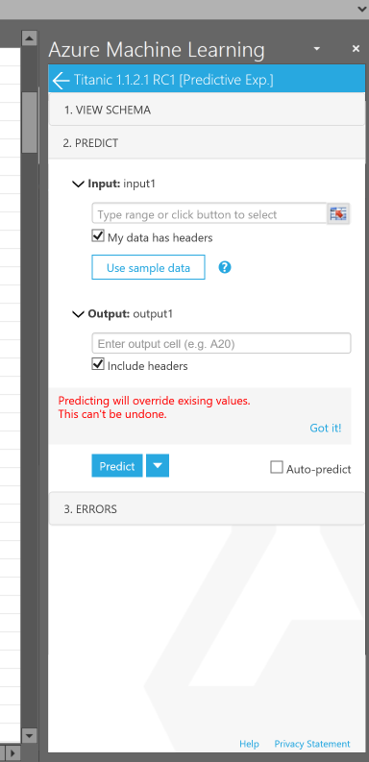
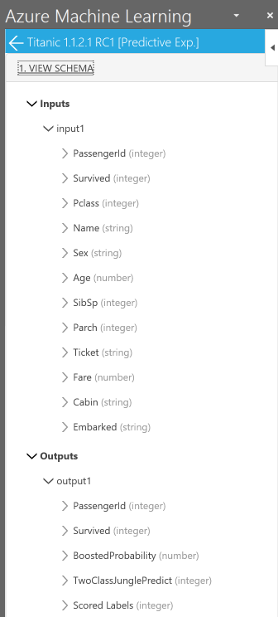
Excel AzureML Add In
You select the free add in to an Excel sheet
Configure the URL and API Key
Allow it to connect
If Web Service creator allows sample data you can download some samples. Otherwise you can view the schema →
to include allowed values/description
Set your input and output cells on the spreadsheet and enter input data
Hit predict and see the output.
Notes:
11:25

Slide 28
MLStudio can help you leverage your data
Data gains tangible value when it can be converted into action
Data in the cloud can be used in the cloud
AzureML Studio allows for expedient data clean up and visualization
Rapid development and tuning of models converts the prepared data into reliable models
Automated conversion into predictive experiments makes it easy to publish web services
Excel can leverage these services for easy feedback on cases
Applications can call the web services to operationalize data and build the outputs into near real time intelligent applications

Slide 29
References
https://docs.microsoft.com/en-us/azure/machine-learning/machine-learning-what-is-machine-learning Azure ML Studio reference documentation
http://download.microsoft.com/download/C/4/6/C4606116-522F-428A-BE04-B6D3213E9E52/ml_studio_overview_v1.1.pdf Overview of capabilities
http://download.microsoft.com/download/A/6/1/A613E11E-8F9C-424A-B99D-65344785C288/microsoft-machine-learning-algorithm-cheat-sheet-v6.pdf Algorithm sheet
https://docs.microsoft.com/en-us/azure/machine-learning/machine-learning-algorithm-choice Algorithm selection guidance
https://azure.microsoft.com/en-us/pricing/details/machine-learning/ Pricing Information
https://studio.azureml.net/ Sign up and get started

Slide 31
Thank you!
@KevQueen
www.dataspelunk.com – blog
kevindqueen@outlook.com kqueen@oakwoodsys.com
Your feedback is welcome!

